Slide 1
“Chinese chess”
Project Report
2018 TAQ Honors Program In Science

Slide 2
01
Introduction
02
Group Division
03
Analysis
Catalog
04
Design
05
Implementation
06
Testing

Slide 3
  Part One : Introduction
Chinese chess, as one of the classic Chinese chess games since ancient times, is convenient, fast and easy to operate. Loved by people. Therefore, our group designed a chess game with good performance, which can meet the needs of most students who love chess.

Slide 4
  Part Two: Group Division
member1 : Part of the Man-machine game and Game start interface.
member2: Part of the rules .
member3: Part of the interface.

Slide 5
  Part Three: Analysis
chessboard
pve
pieces
category
the optimal moving
pvp
move
rule judge
evaluation function
outcome
operation
interface

Slide 6
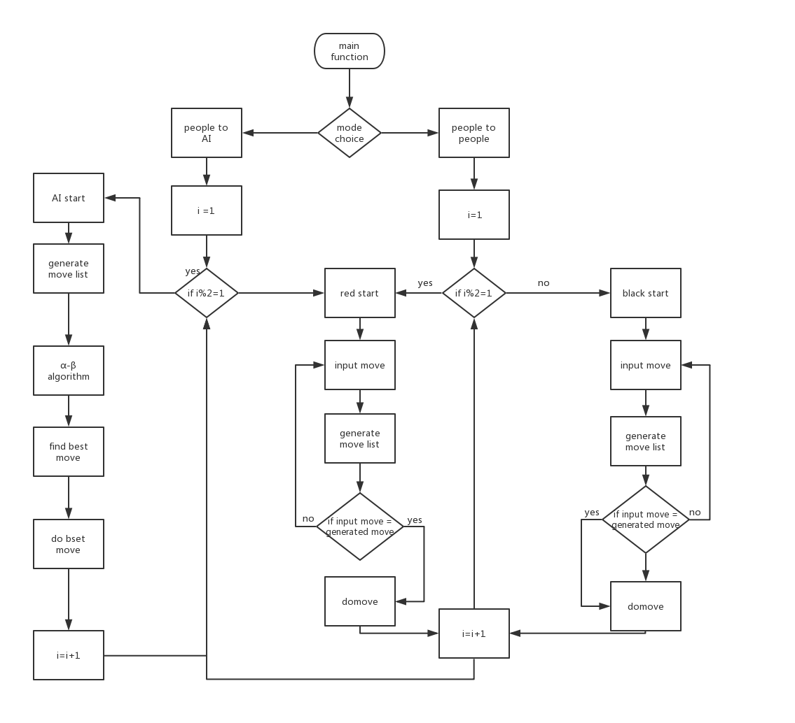
  Part Four: Design
main

Slide 7
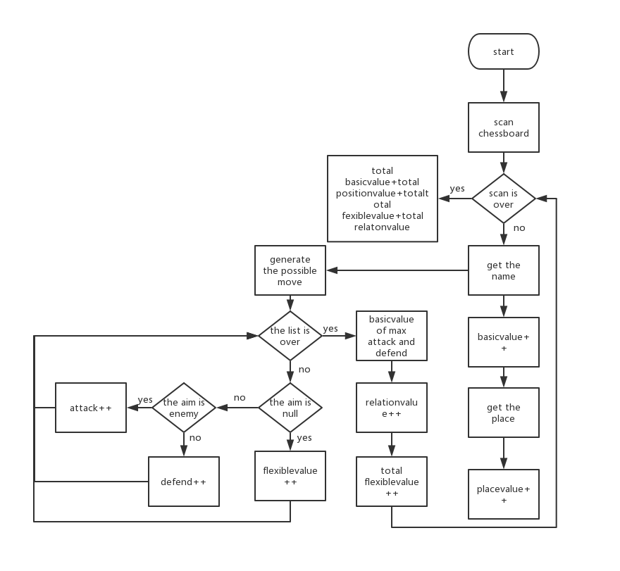
  Part Four: Design
evaluate

Slide 8
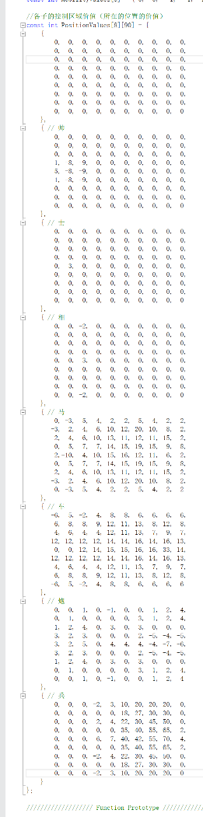
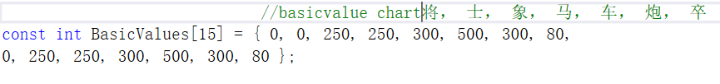
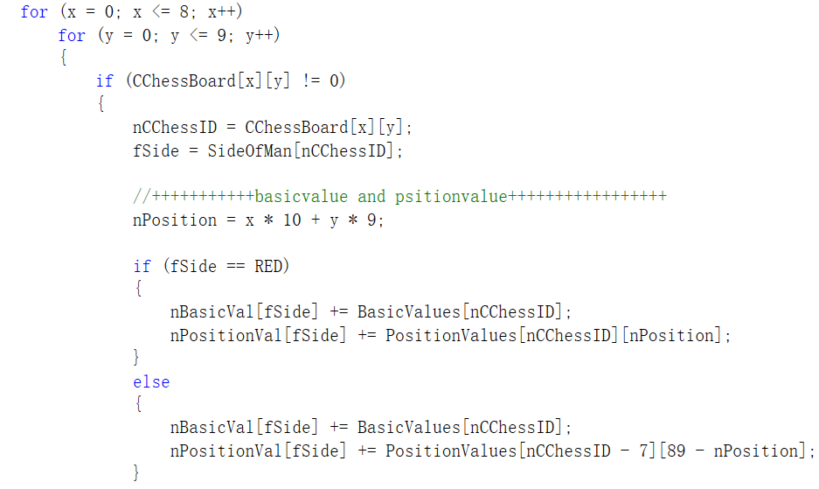
  Part Five : Implementation

Slide 9
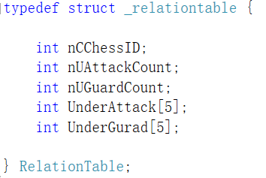
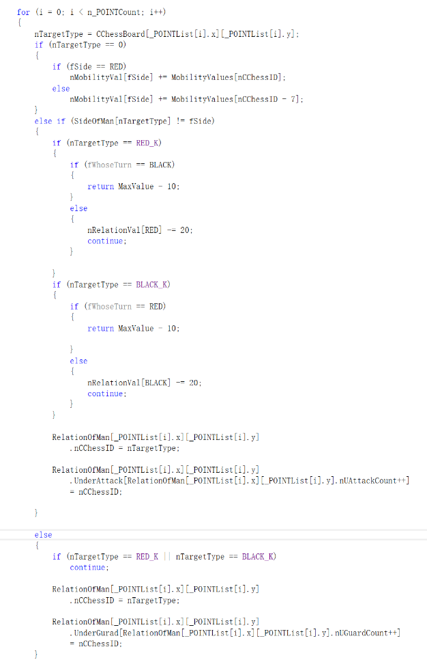
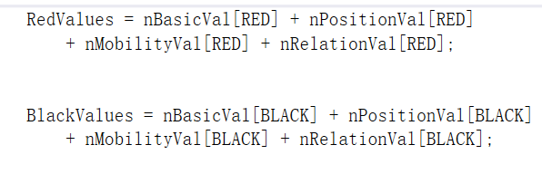
  Part Five : Implementation

Slide 10
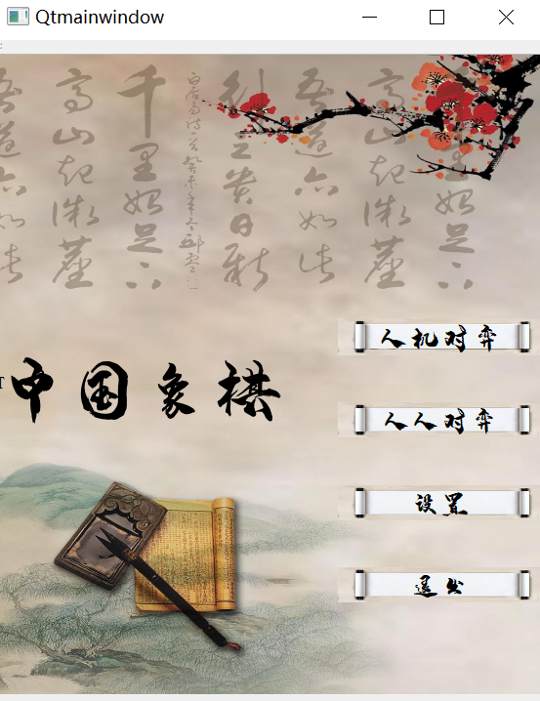
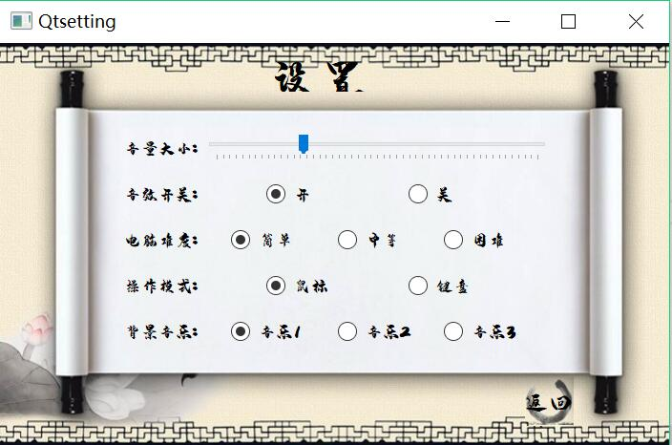
  Part Six: Testing

Slide 11
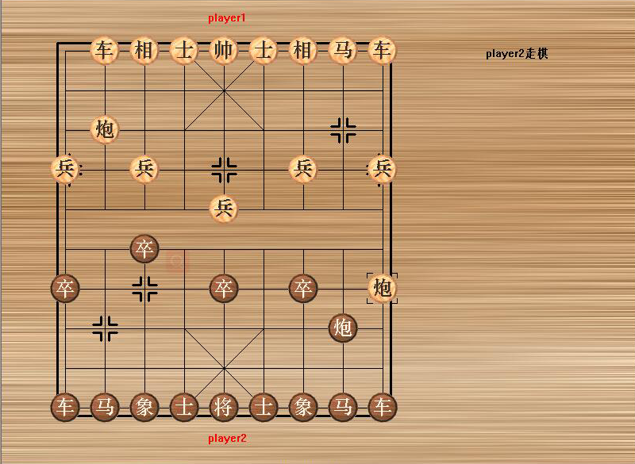
  Part Six: Testing

Slide 12

Thanks
延时符

